Slide 1
Frequent Itemset Mining Algorithm for Big Data
PRESENTED BY:- ANKIT YADAV
ASHISH GUPTA
SMRITI

Slide 2
INTRODUCTION
Big Data
Big data analytics analyse the huge amount of data by different algorithms and reveals the hidden patterns, trends
Association Rule Mining
Finding Frequent Itemset
Generate Association Rules
There are various types of Frequent itemset Mining Algorithms
Need for parallel version of FP-Growth, S-FPG (Spark FP-Growth)

Slide 3
BIG DATA- NOT ONLY DATA VOLUME
The most well known definition given by Big Data is a four Vs concept.
Volume:-Represents scale of data
Velocity :- Speed of generation and processing of data
Variety:- Refers different form of data i.e. unstructured or semi structured data
Veracity :- Refers uncertainty of data i.e. quality of data being captured

Slide 4
BIG DATA
Walmart handles more than 1 million customer transactions every hour.
Facebook handles 40 billion photos from its user base.
Decoding the human genome originally took 10years to process; now it can be achieved in one week.
There are about 1 trillion web pages.
One hour of video is uploaded to YouTube every second.

Slide 5
FREQUENT ITEMSET MINING
Frequent Itemset Mining is a popular data mining task with the aim of discovering frequently co-occurring items and, hence, correlations, hidden in data
Many attempts to apply this family of techniques to Big Data have been presented, but very few have proved to be efficient

Slide 6
FREQUENT IMTEMSET APPLICATIONS
Customer Analysis
Classification, Clustering
Outlier Analysis
Web Mining Applications
Search Engine
Recommender System
Health Care and Medicine
Software Bug Detection
Politics
National Security

Slide 7
ASSOCIATION RULE MINING
Association rule mining [14] was proposed to discover certain interesting correlation relationships among the item sets of the data.
An Association rule defines relation between two sets of items for e.g.
{Diapers}->{Beer}
Steps of Association Rule Mining
Finding Frequent Itemset
Generate Association Rules
Finding frequent itemset from a large transactional database can be computationally expensive.
A dataset containing k items can generate up to 2^{k}-1 frequent itemsets.

Slide 8
There are several algorithms for mining frequent itemset efficiently by reducing the computational complexity
Apriori Algorithm [13]
FP Growth algorithm [6]
Tree Projection Algorithm
Eclat Algorithm : It performs mining from vertical transposition of the dataset [2].

Slide 9
FP-GROWTH
Allows frequent itemset discovery without candidate itemset generation.
Two step approach:-
Build a compact data structure called the FP-tree
Built using 2 passes over the data-set.
Extracts frequent itemsets directly from the FP-tree
Traversal through FP-Tree

Slide 10
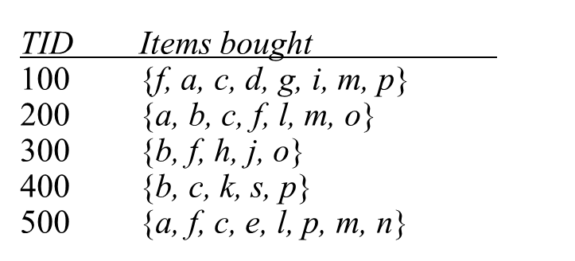
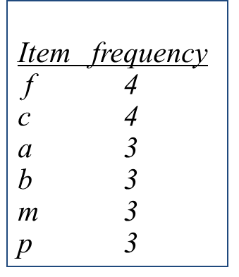


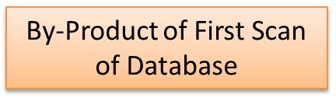
FP-tree Example: step 1

Slide 11
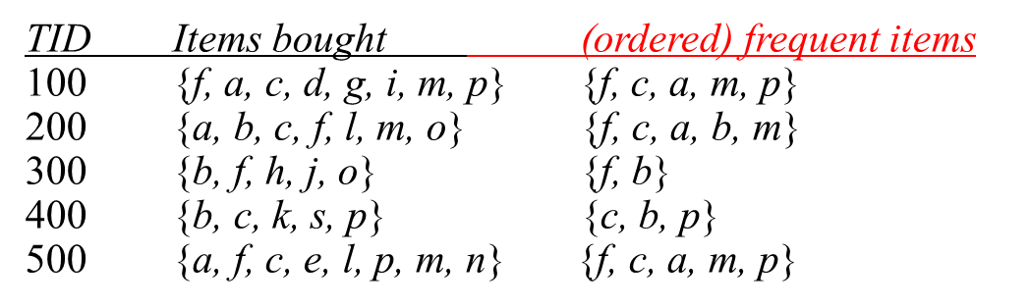
FP-tree Example: step 2
Step 2: scan the DB for the second time, order frequent items in each transaction

Slide 12
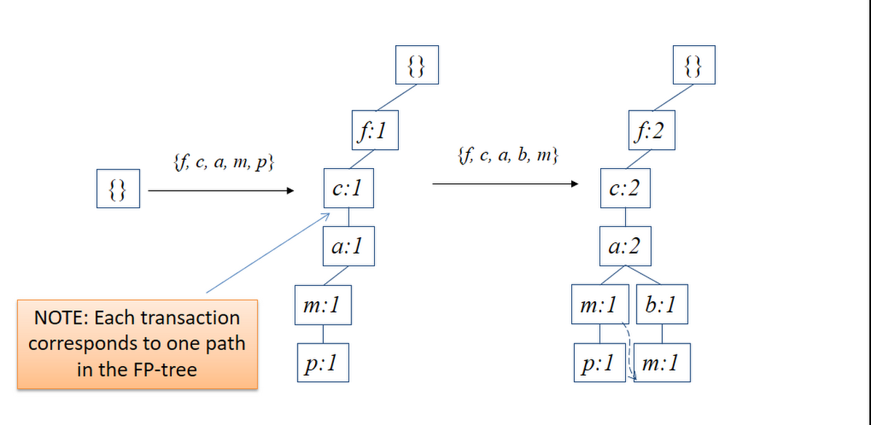
FP-tree Example: step 3

Slide 13
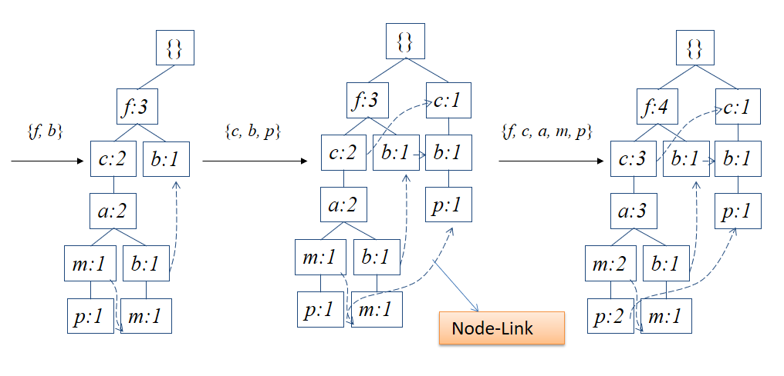
FP-tree Example: step 4

Slide 14
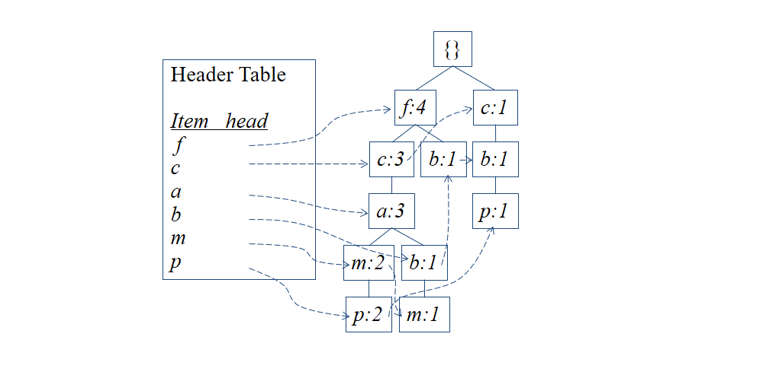
FP-tree Example: step 5

Slide 15
ADVANTAGES OF FP-TREE STRUCTURE
The most significant advantage of the FP-tree
Scan the DB only twice and twice only.
Uses a pattern fragment growth method to avoid costly generation of a large number of candidate item sets
Use divide and conquer method to decompose mining task into a set of smaller task for mining confined pattern in conditional database which reduces the search space
Completeness:
the FP-tree contains all the information related to mining frequent patterns from the transaction database
Compactness:
The size of the tree is bounded by the size of its corresponding database because each transaction will contribute one path to the tree
The height of the tree is bounded by the maximum number of frequent items in a transaction

Slide 16

APACHE HADOOP
The Apache Hadoop software library is a framework that allows for the distributed processing of large data sets across clusters of computers.
The base Apache Hadoop framework is composed of the following modules:
Hadoop Common – contains libraries and utilities needed by other Hadoop modules;
Hadoop Distributed File System (HDFS) – a distributed file-system that stores data on commodity machines, providing very high aggregate bandwidth across the cluster;
Hadoop YARN – a platform responsible for managing computing resources in clusters and using them for scheduling users' applications.
Hadoop MapReduce – an implementation of the MapReduce programming model for large-scale data processing. [15]

Slide 17
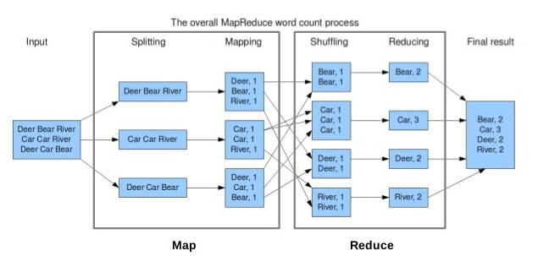
MAP REDUCE FRAMEWORK

Slide 18

APACHE SPARK
Has its architectural foundation the Resilient Distributed Dataset (RDD).
Can work in an independent manner as well as in integration with Hadoop.
Allows real time streaming process.
Supports a lot of languages.
Process data at a lighting fast pace.
Sophisticated analytics.

Slide 19
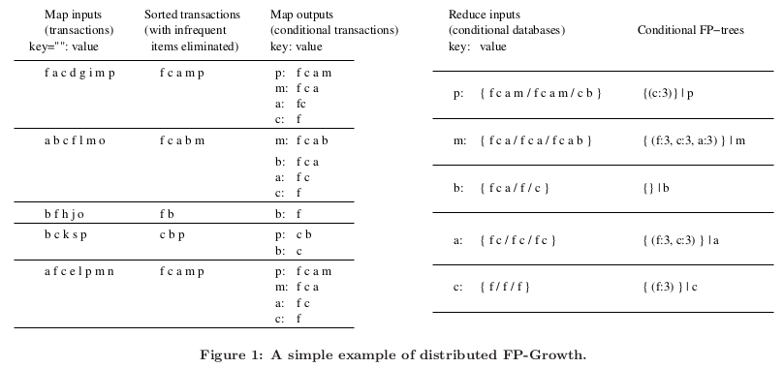
EXPERIMENT

Slide 20
RESULTS
We have both used synthetic and real-life datasets in our experiment from [12].
Dataset | Number of Transaction(N) | Number of items(I) | Size of dataset
Retail | 88162 | 16470 | 4.2 MB
T40I10D100K | 100000 | 942 | 15.5 MB
T10I4D100K | 100000 | 870 | 4 MB
mushroom | 8124 | 119 | 570.4 KB
pumsb_star | 49046 | 2088 | 11.3 MB

Slide 21
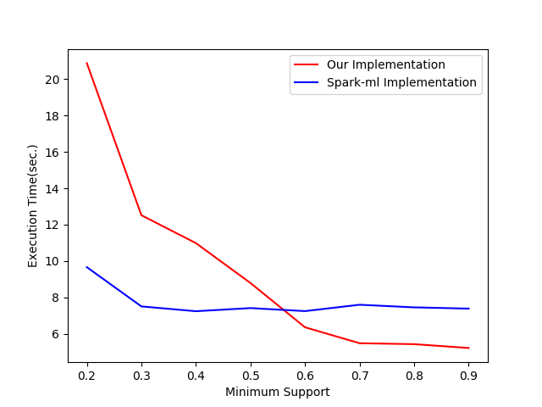
Figure 2: Mushroom Dataset Analysis

Slide 22
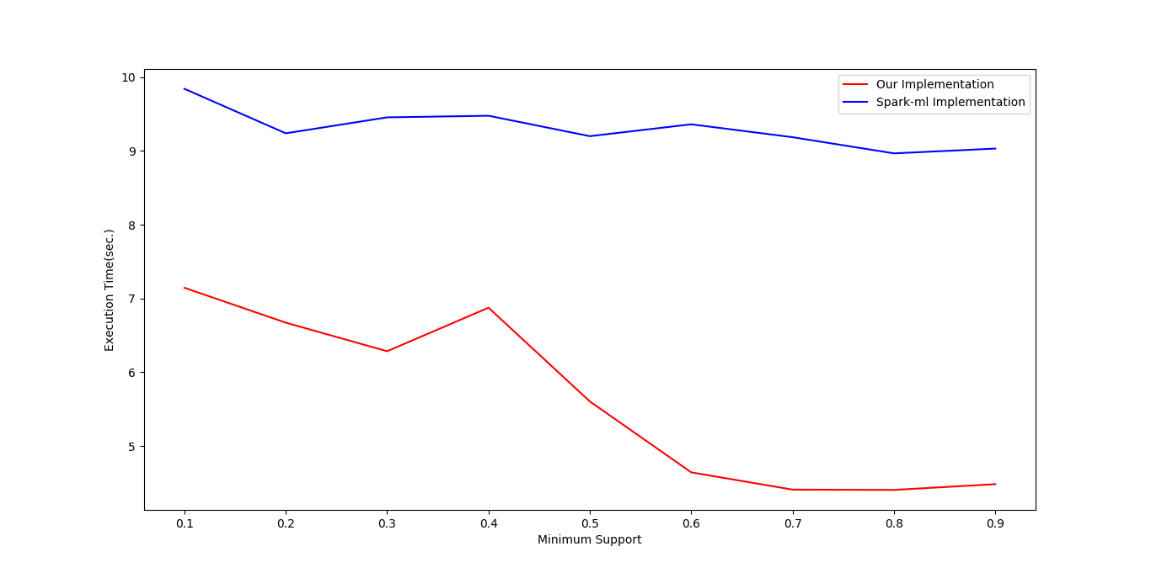
Figure 3: Retail Dataset Analysis

Slide 23
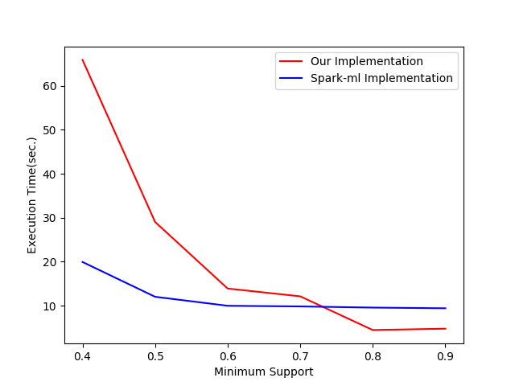
Figure 4: Pumsb_star Dataset Analysis

Slide 24
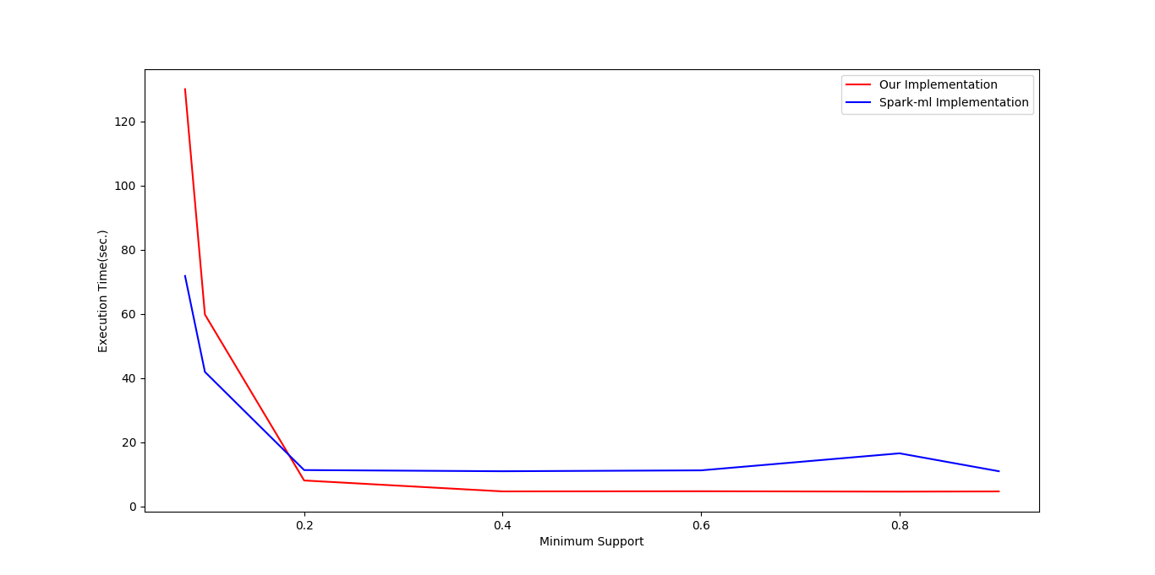
Figure 5: T40I10D100K Dataset Analysis

Slide 25
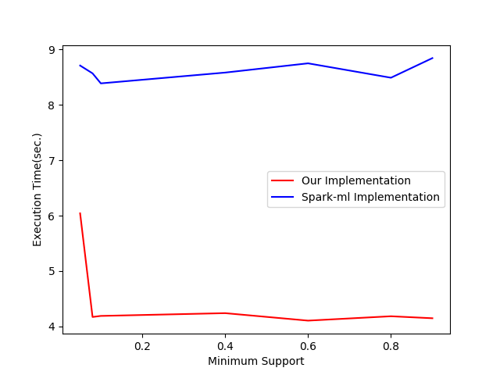
Figure 6: T10I4D100K Dataset Analysis

Slide 26
BRIEF DISCUSSION
PFP implementation of spark-ml performs better than our implementation particularly with the datasets who’s each transaction contain large number of frequent items and for low value of minimum support.
We also observe that Our implementation outperforms spark-ml for higher value of minimum support.
In this paper we presented the Parallel Projection method of FP-Growth algorithm to mine frequent itemsets from transactional data.

Slide 27
REFERENCES
[1] Sudhakar Singh, Pankaj Singh, Rakhi Garg and P K Mishra, “Big Data: Technologies, Trends and Applications”, In: International Journal of Computer Science and Information Technologies, Vol. 6(5), 2015
[2] Daniele Apiletti, Elena Baralis, Tania Cerquitelli, Paolo Garza, Fabio Pulvirenti and Luca Venturini, “Frequent Itemsets Mining for Big Data: A Comparative Analysis”, Elsevier Inc. All rights reserved, 2017
[3] Arkan A. G. AL-HAMODI and Song-feng LU, “MapReduce Frequent Itemsets for Mining Association Rules”, In: International Conference on Information System and Artificial Intelligence, 2016
[4] Aissatou Diaby dite Gassama, Fode Camara, Samba Ndiaye, “S-FPG: A Parallel Version of FP-Growth Algorithm under Apache SparkTM”, In: The 2nd IEEE International Conference on Cloud Computing and Big Data Analysis,2017
[5] Daniele Apiletti, Paolo Garza, and Fabio Pulvirenti, “A Review of Scalable Approaches for Frequent Itemset Mining”, T. Morzy et al. (Eds): ADBIS 2015, CCIS 539, pp. 243–247, Springer International Publishing Switzerland, 2015

Slide 28
REFERENCES(CONTD.)
[6] JIAWEI HAN, JIAN PEI†, YIWEN YIN and RUNYING MAO, “Mining Frequent Patterns without Candidate Generation: A Frequent-Pattern Tree Approach∗”, In: Data Mining and Knowledge Discovery, 8, 53–87, 2004
[7] Jianwei Li, Ying Liu, Wei-keng Liao, Alok Choudhary, “Parallel Data Mining Algorithms for Association Rules and Clustering”, CRC Press, LLC, 2006
[8] Haoyuan Li, Yi Wang, Dong Zhang, Ming Zhang, and Edward Chang, “PFP: Parallel FP-Growth for Query Recommendation”, ACM New York, NY, USA, 2008
[9] Thanmayee and H R Manjunath Prasad, “Revamped Market-Basket Analysis Using In-Memory Computation Framework”, In: 11th International Conference on Intelligent Systems and Control (ISCO), 2017

Slide 29
REFERENCES(CONTD.)
[10] Bart Goethals (HIIT Basic Research Unit), “Survey on Frequent Pattern Mining”, 2003
[11] Apache Spark, https://spark.apache.org
[12] FIMI (Frequent Itemset Mining Dataset) Repository, fimi.ua.ac.be/data
[13] Rakesh Agrawal and Ramakrishnan Srikant Fast algorithms for mining association rules. Proceedings of the 20th International Conference on Very Large Data Bases, VLDB, pages 487-499, Santiago, Chile, September 1994
[14] Agrawal, R.; Imieliński, T.; Swami, A. (1993). "Mining association rules between sets of items in large databases". Proceedings of the 1993 ACM SIGMOD international conference on Management of data - SIGMOD '93. p. 207. doi:10.1145/170035.170072. ISBN 0897915925
[15] Apache Hadoop, http://hadoop.apache.org/

Slide 30


